Slide 1
Hardware Development with NFC
张庭梁
Future Laboratory, Academy of Art and Design
Tsinghua University

Slide 2
About Me
本科电机系，跑路到美院信息艺术设计交叉学科，目前研一
一直在搞乱七八糟的硬件开发，啥好玩就搞什么
曾任清华大学“未来通信”学生科技兴趣团队理事长， “天空工场”学生科技兴趣团队“未来航空队”队长
去年挑战杯特奖（狗头

Slide 3
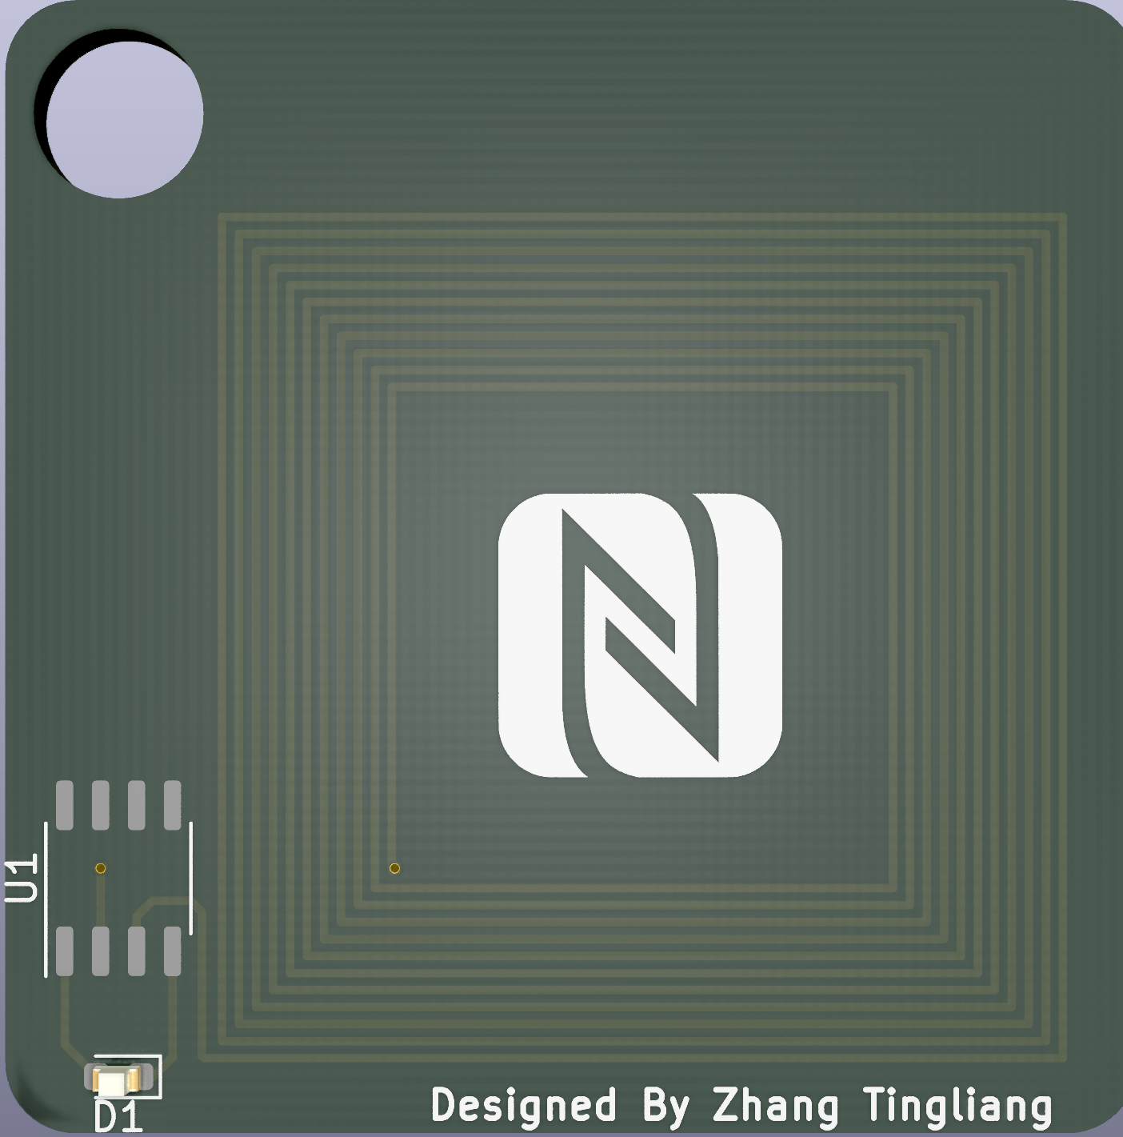
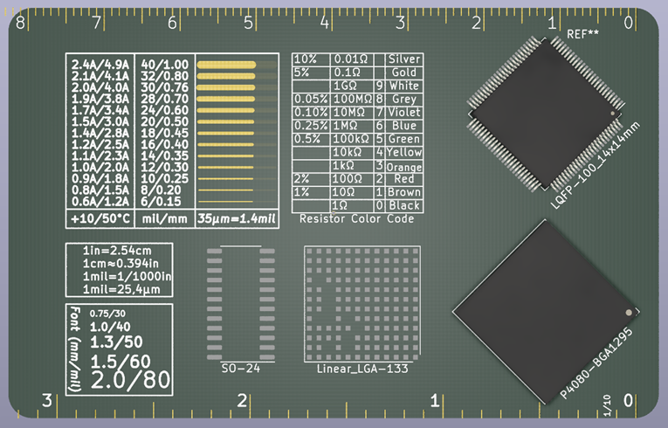

Preview of iTag

Slide 4
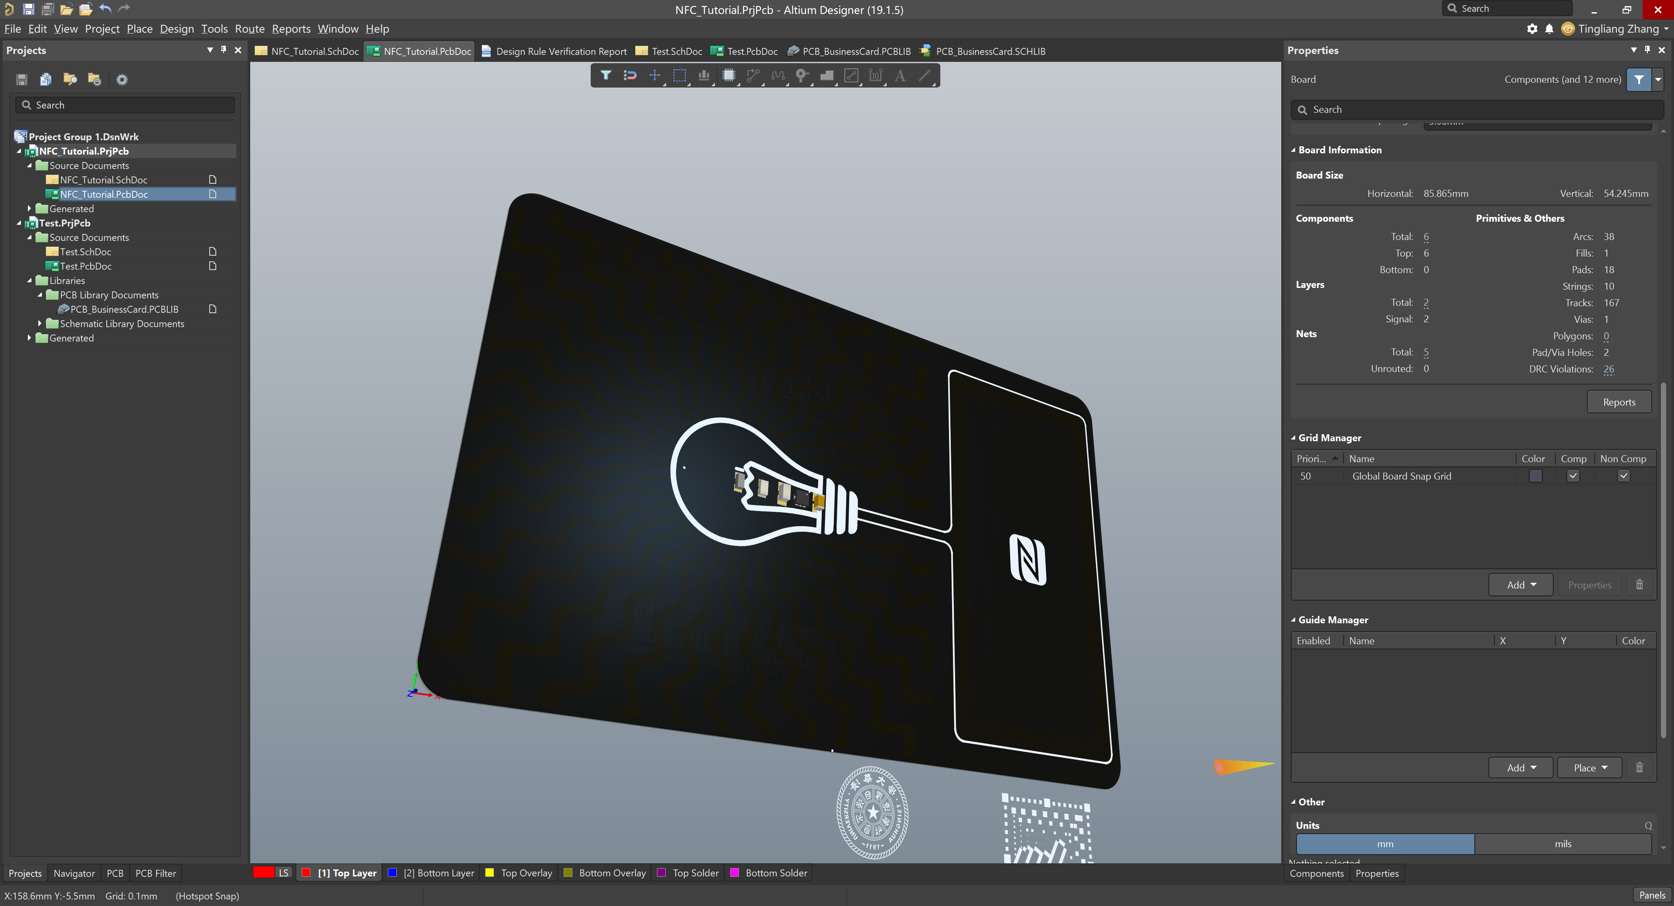

Slide 5
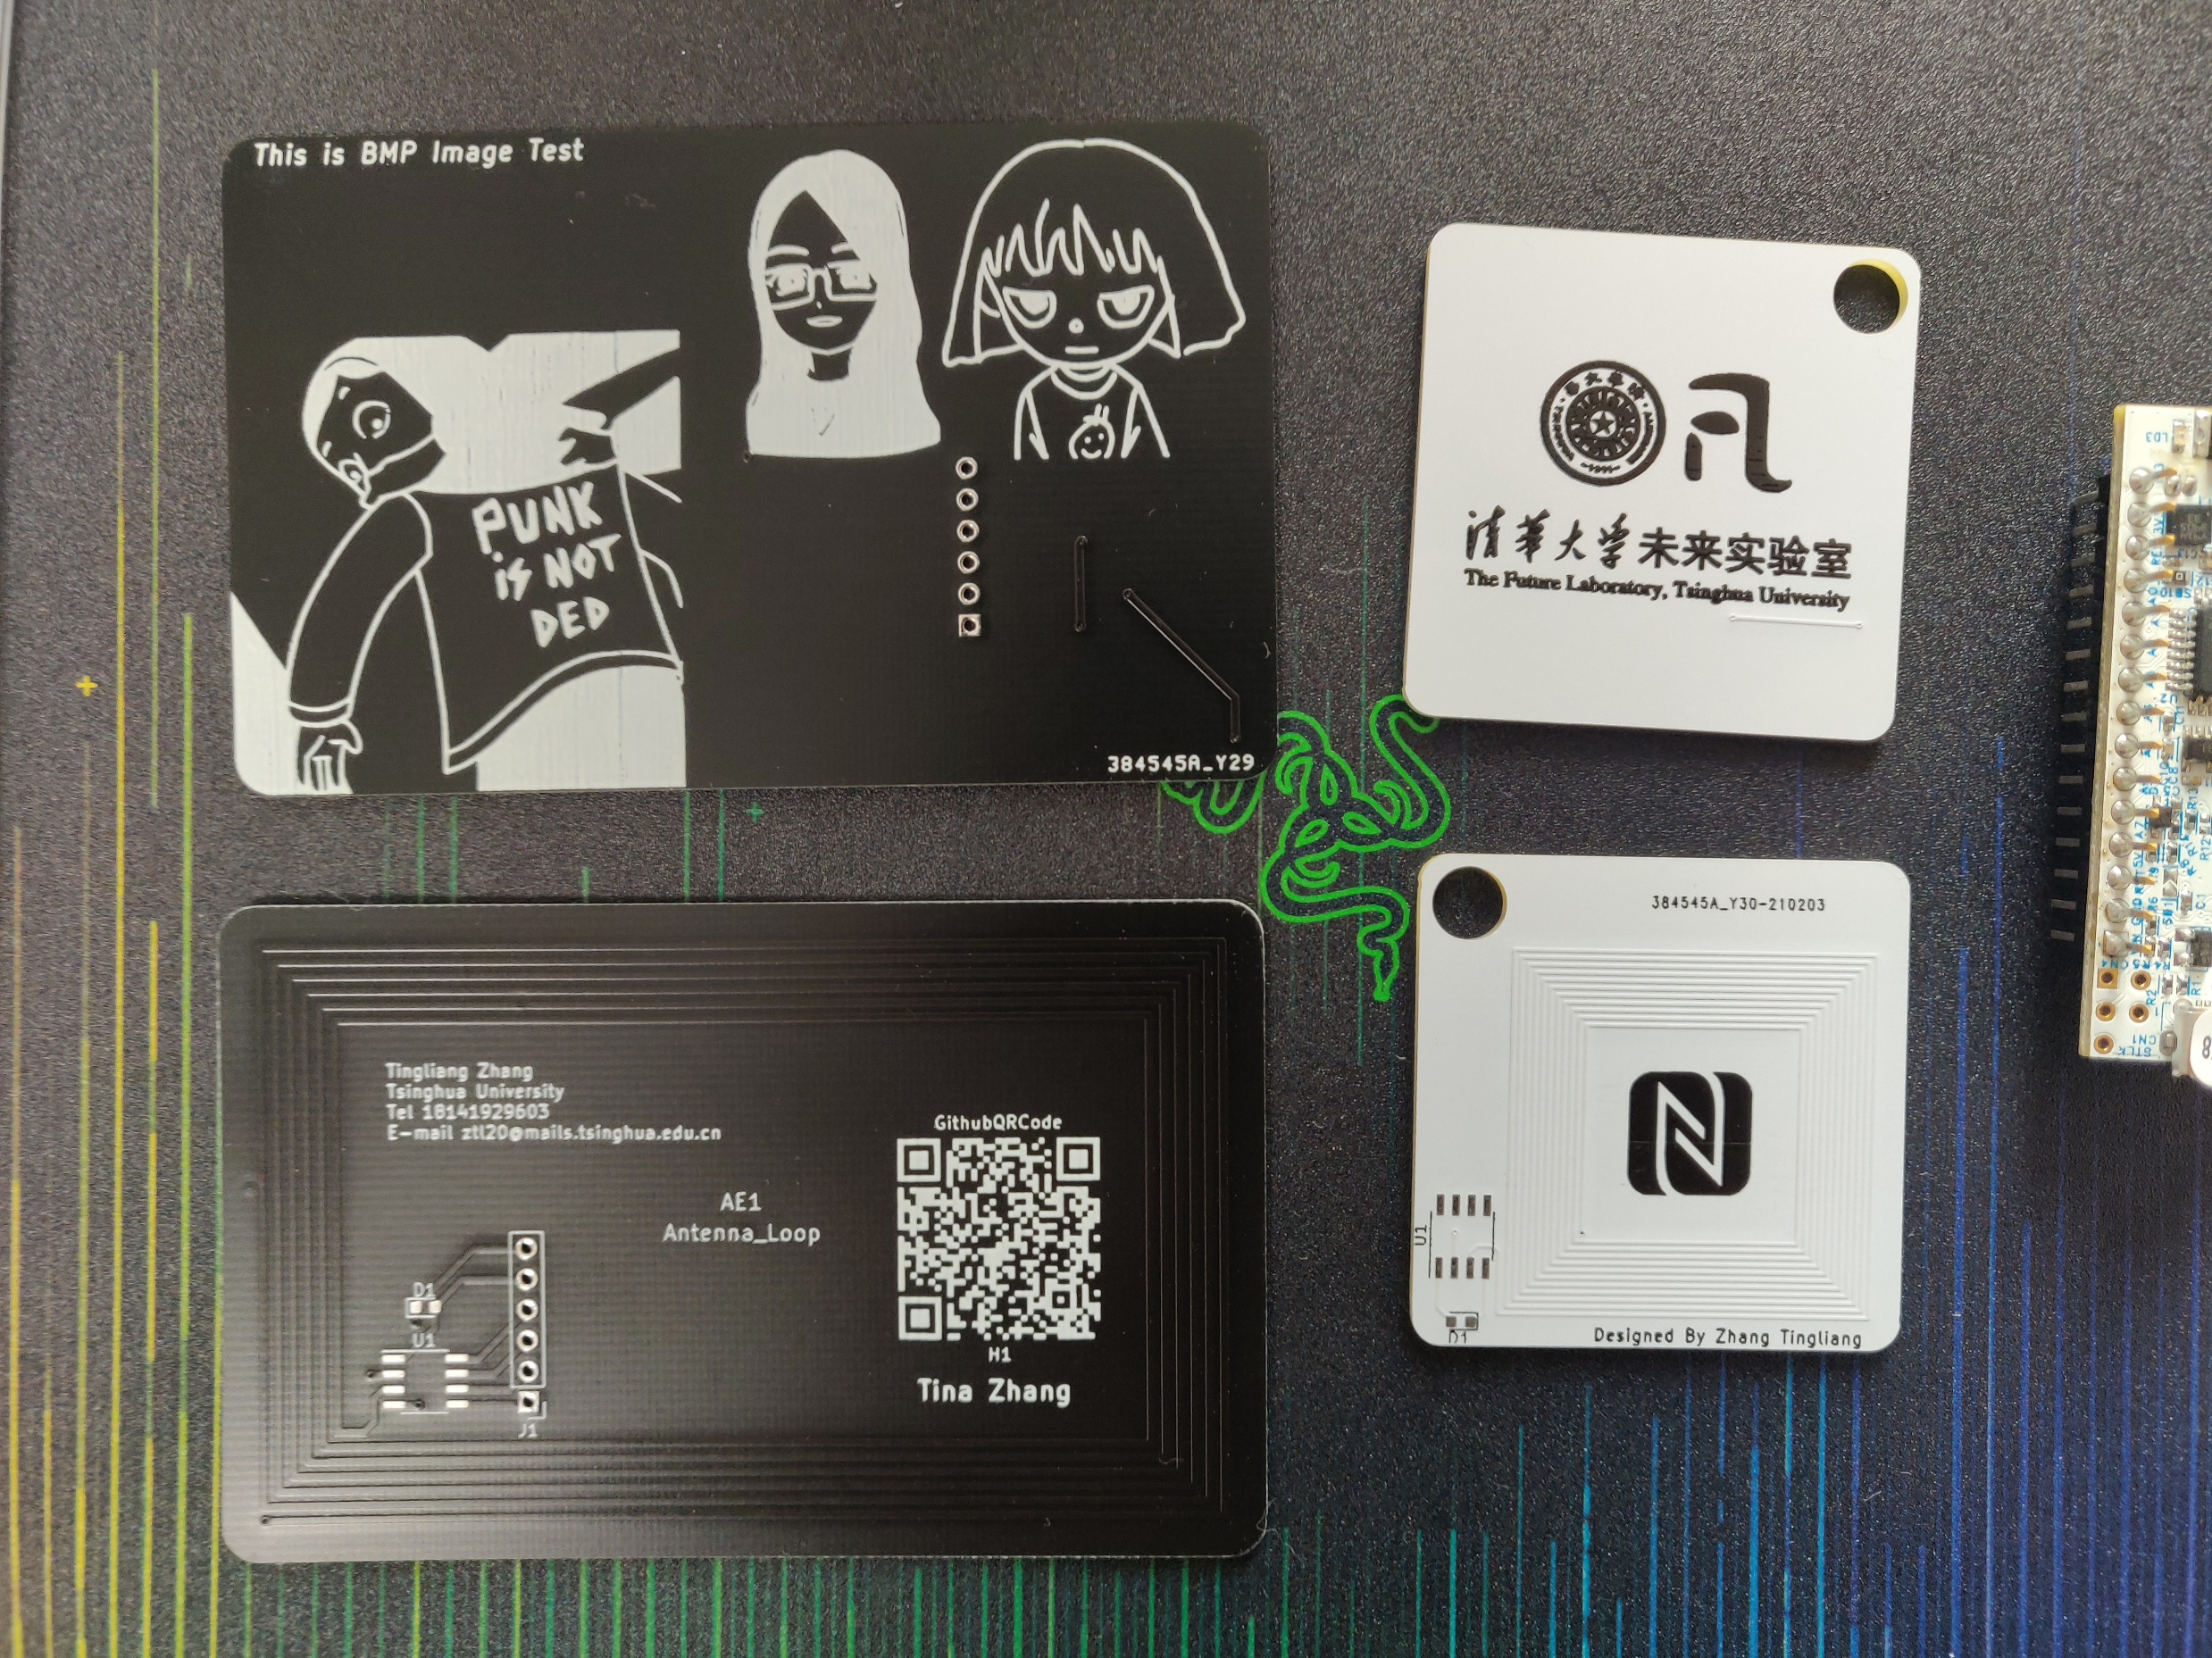

Slide 6
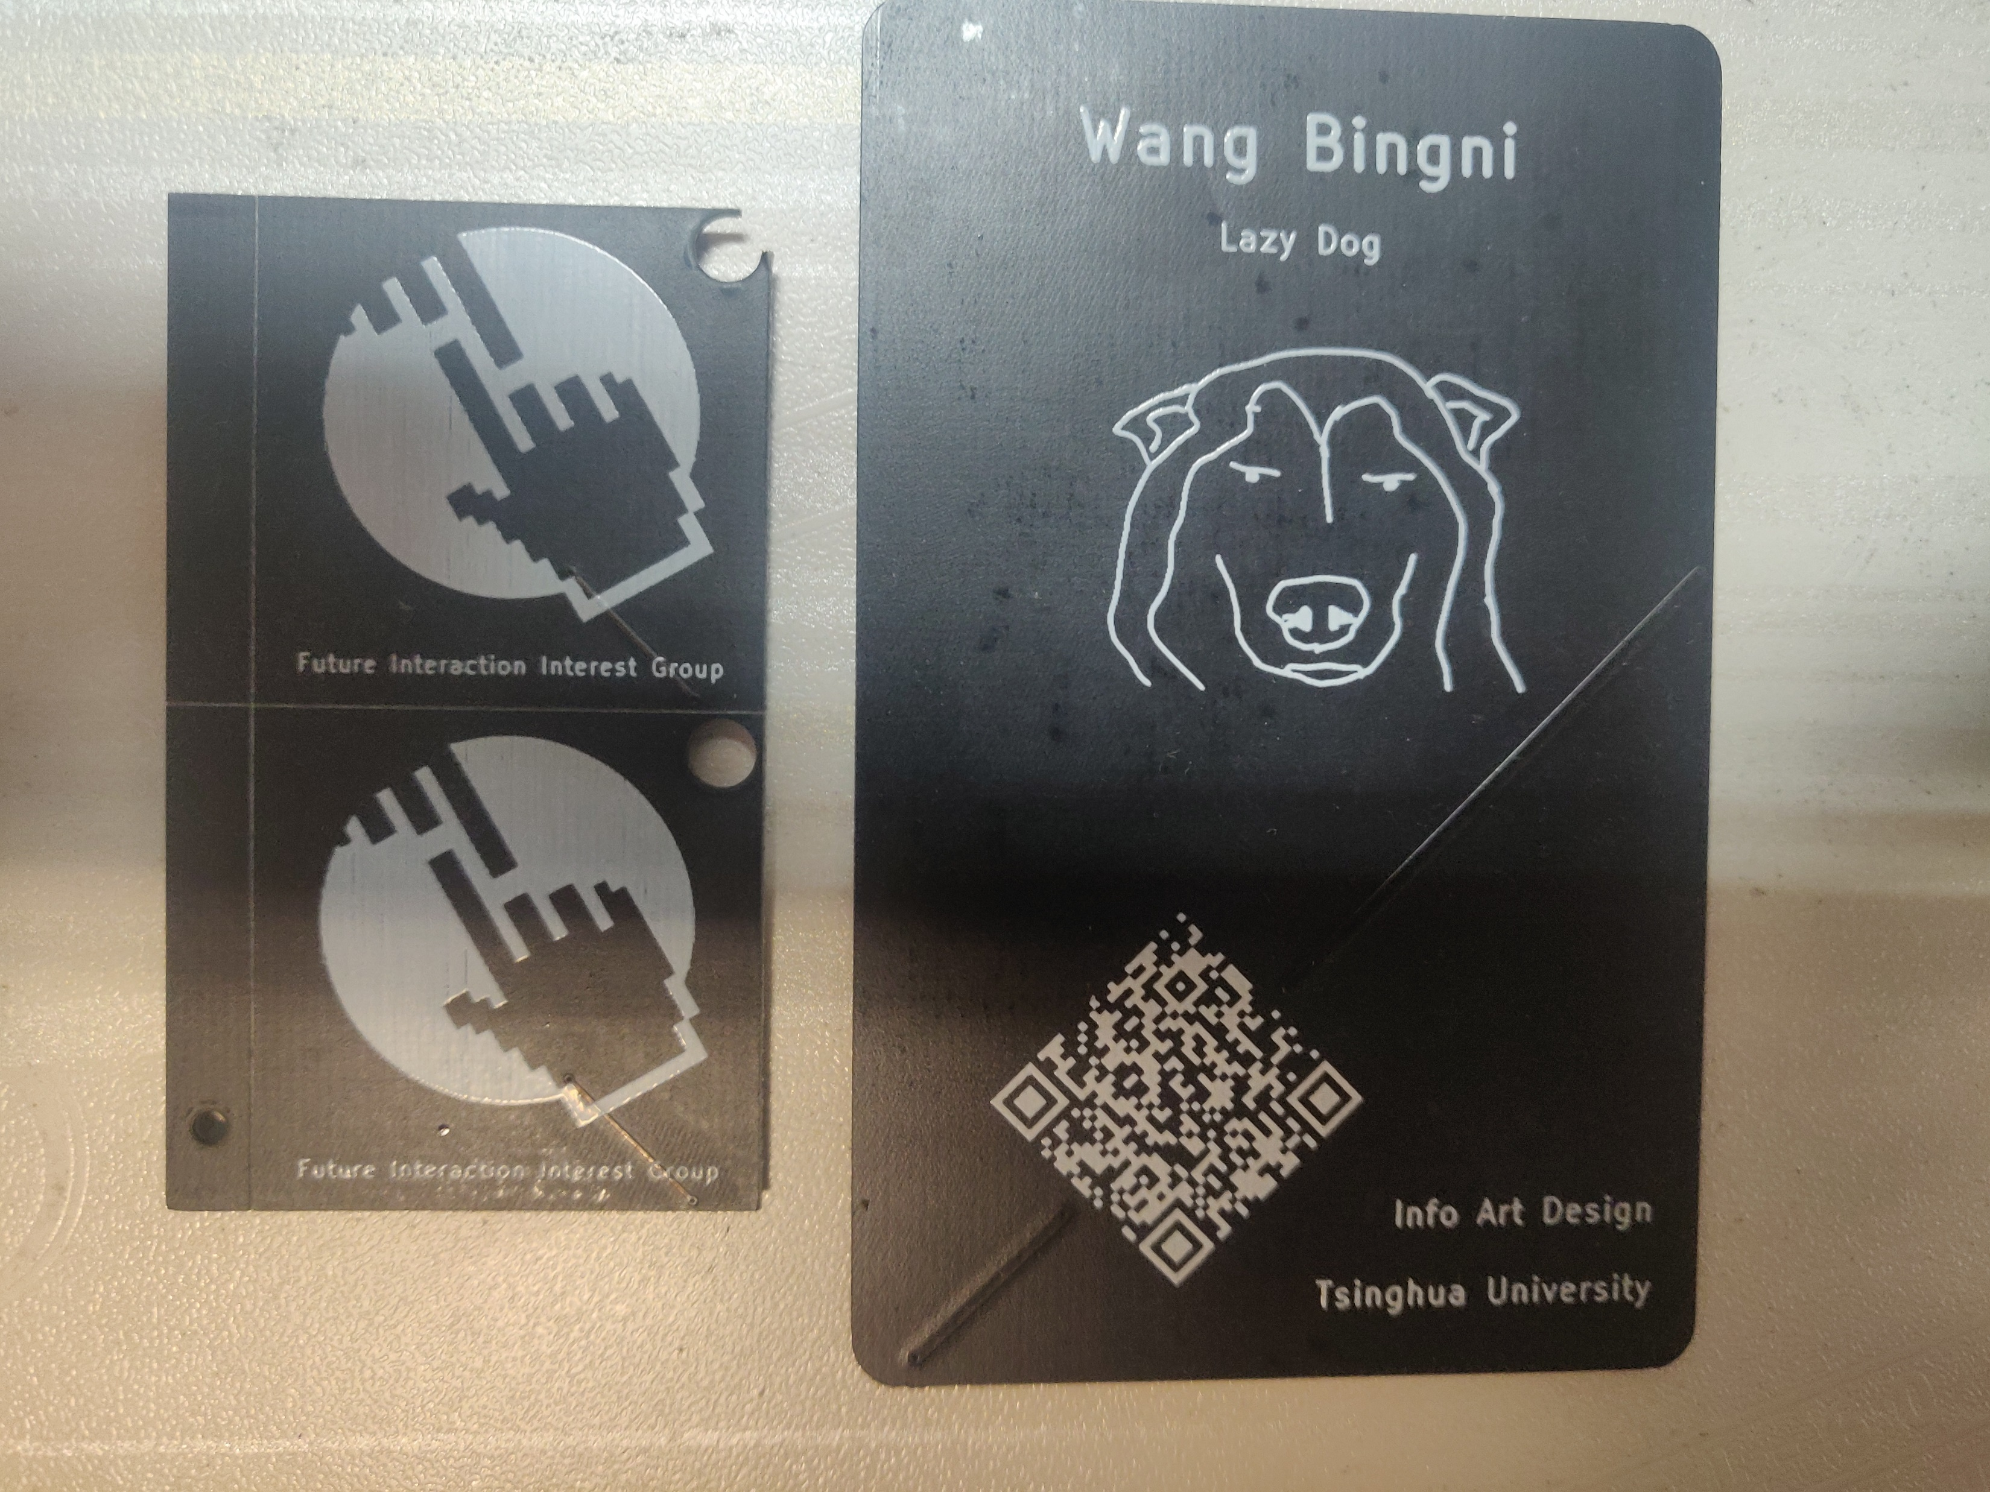

Slide 7
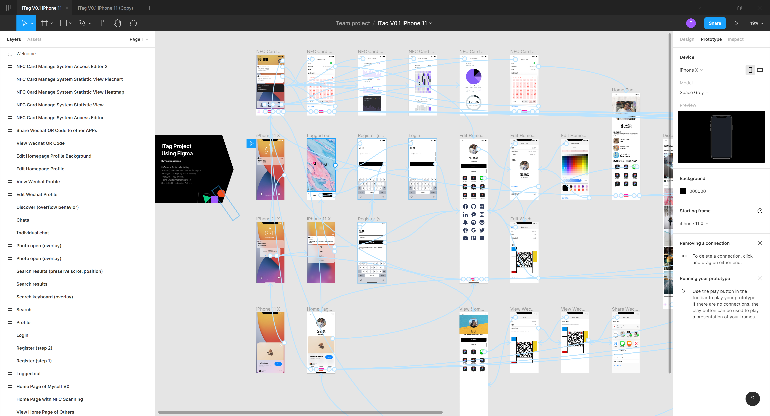

Slide 8


Slide 9
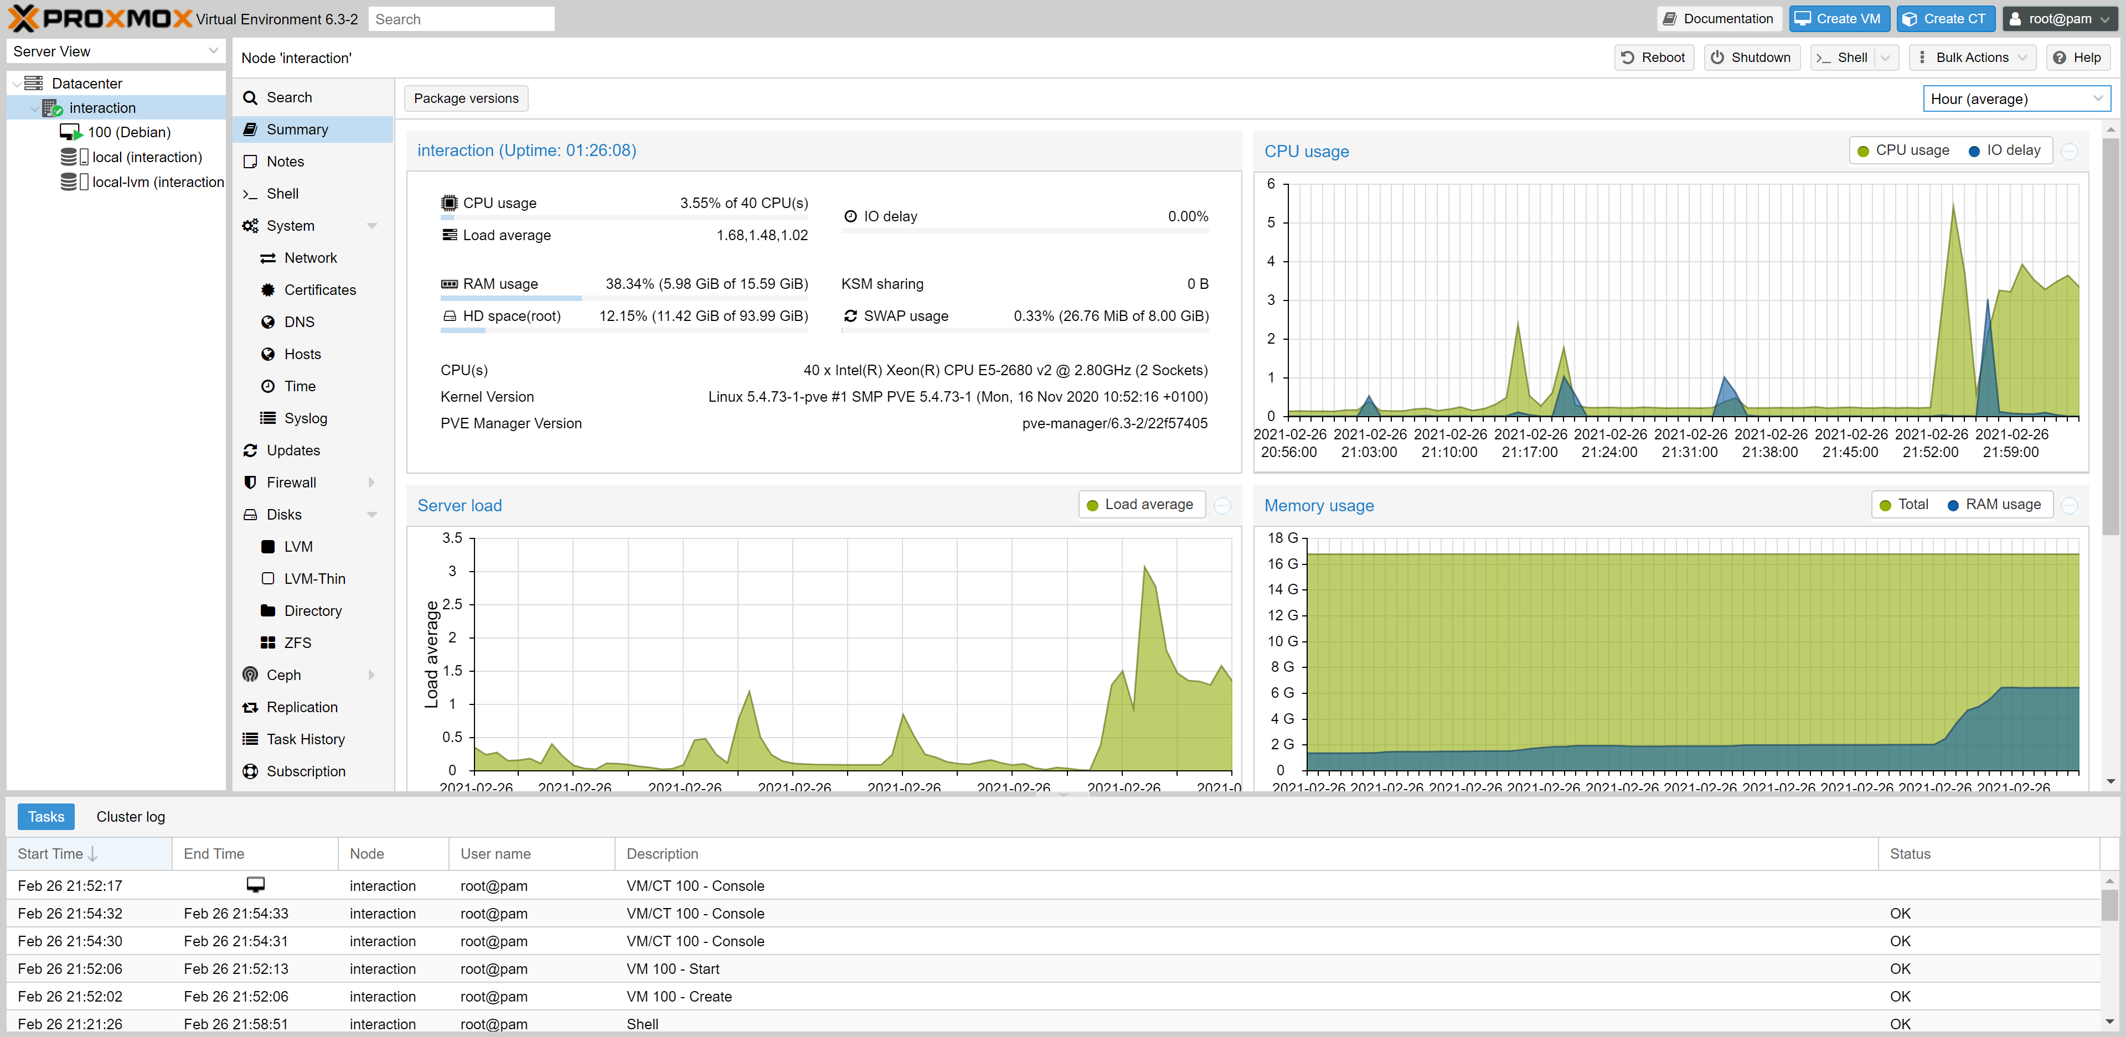

Slide 10
Quiz
导体和绝缘体区分
电路串并联
电路板是什么
在面包板上搭过电路
画过电路板
做过完整的硬件工程
独立做过软硬件结合的项目
做过硬件相关的产品并找好供应链量产

Slide 11
Outline
PPT部分
了解NFC和PCB
如何设计一款NFC卡片
操作部分
从设计到交付的全流程
学会读懂Datasheet并按照厂商的标准来设计
PCB设计软件的使用
Datasheet阅读
原理图设计
元件选型和采购，封装确认
绘制天线
PCB Layout设计
交付打样的流程

Slide 12


NFC
Near-field communication

Slide 13
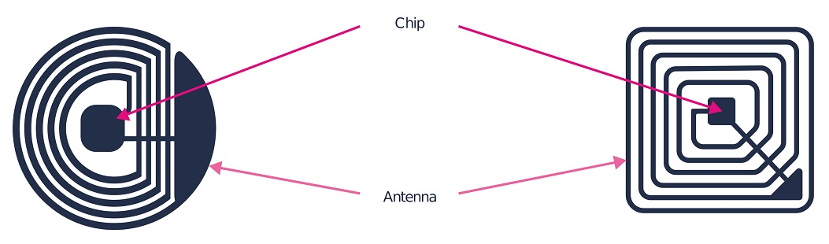
NFC Tags and chips
The two components, the NFC chip and antenna, work together to form a self-contained functional device.

Slide 14
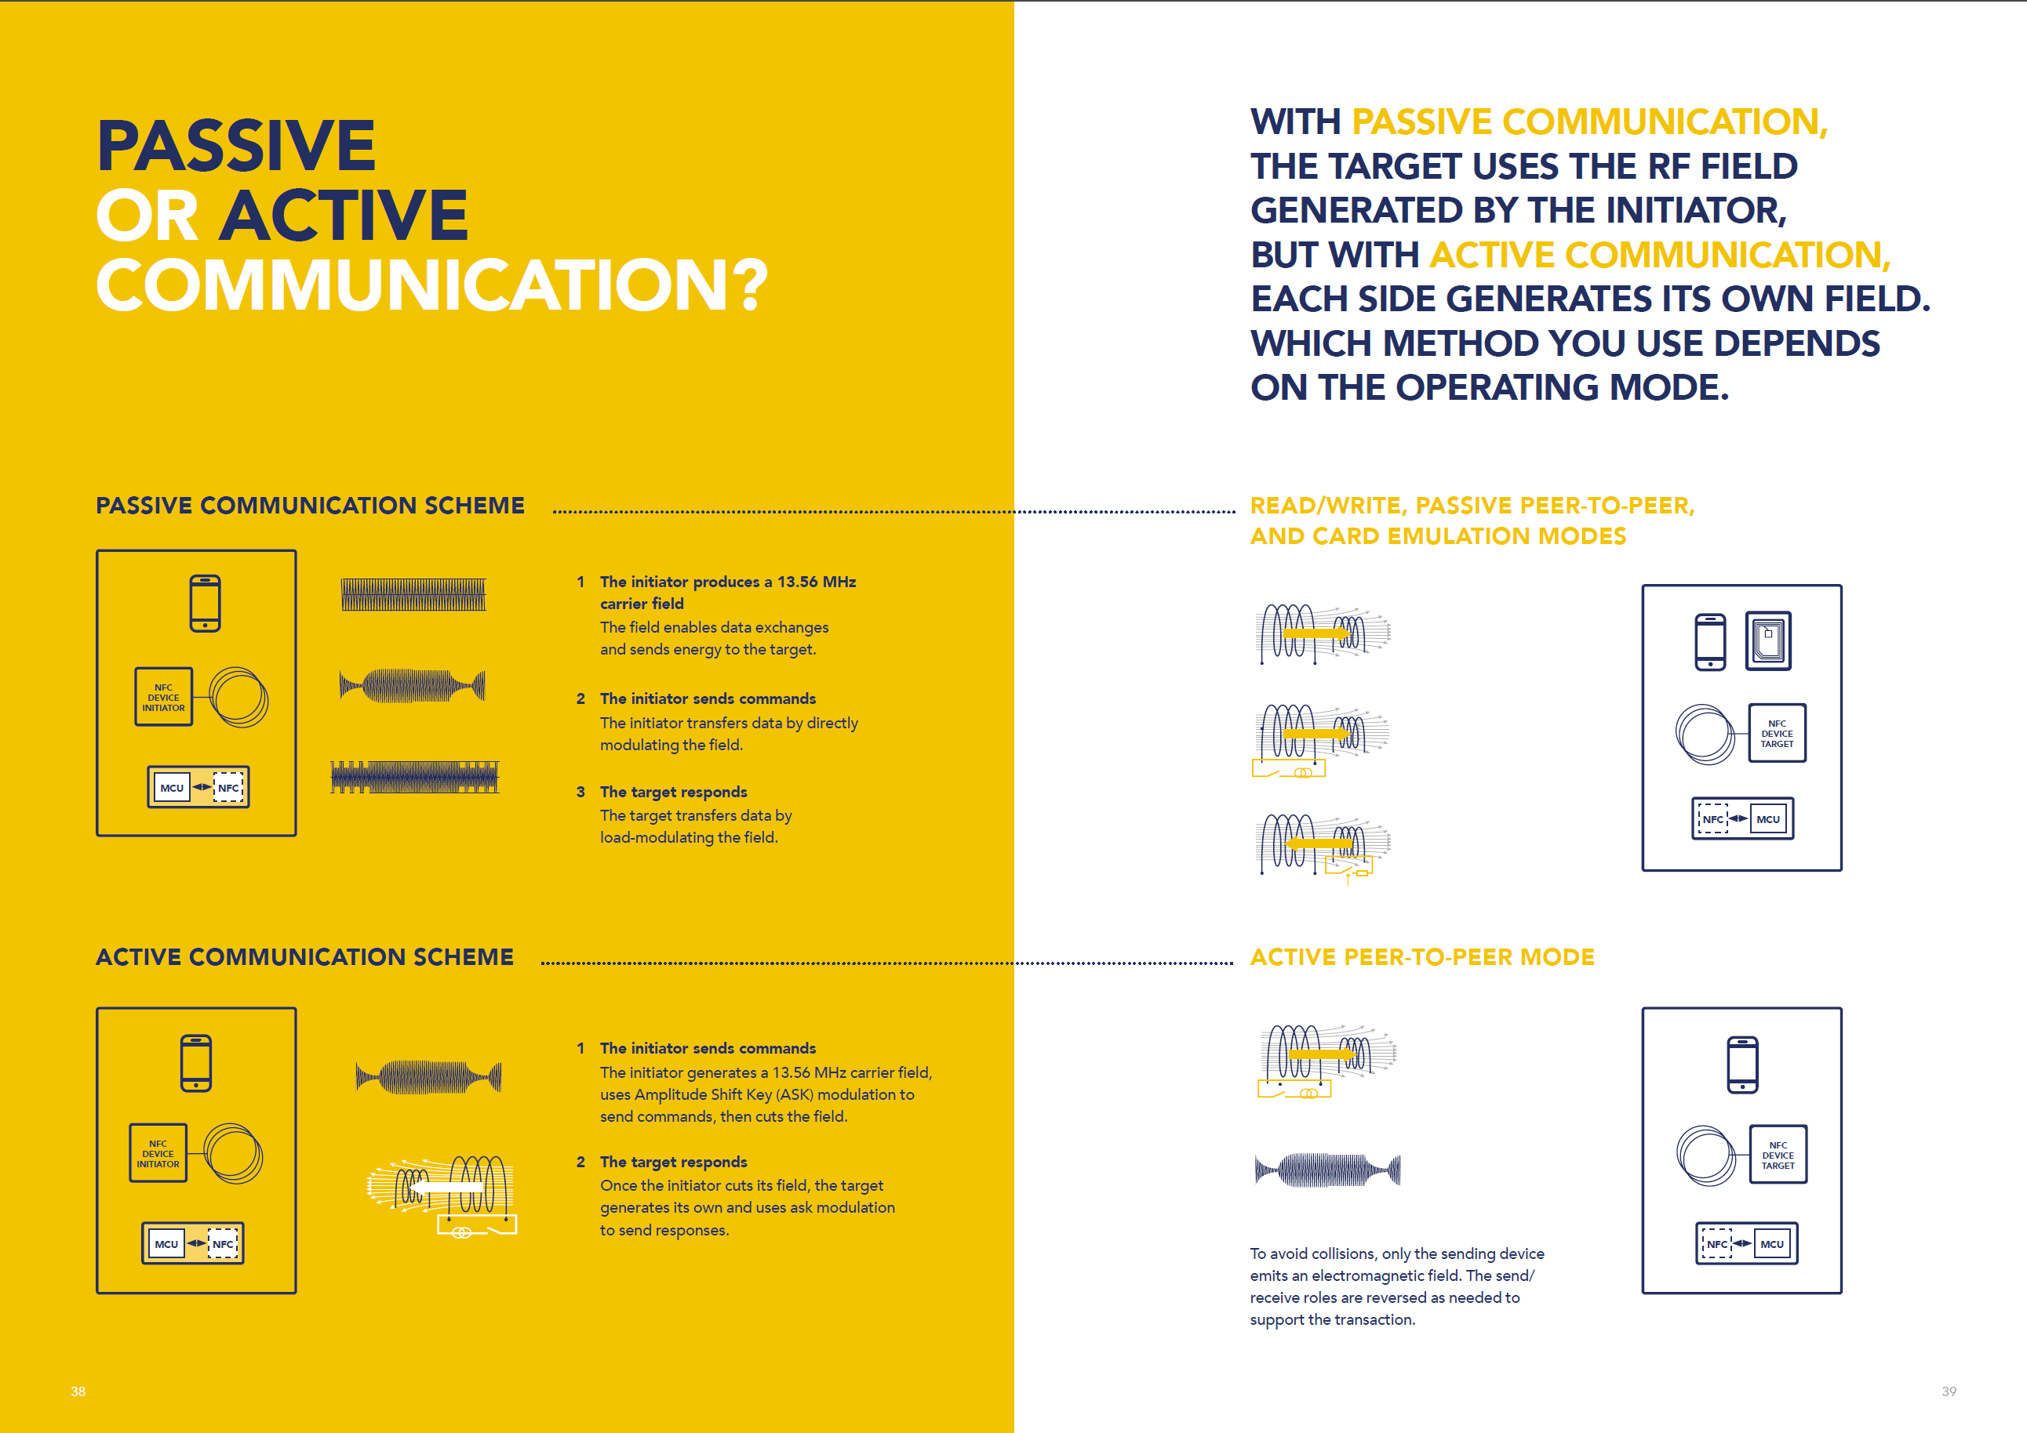

Slide 15
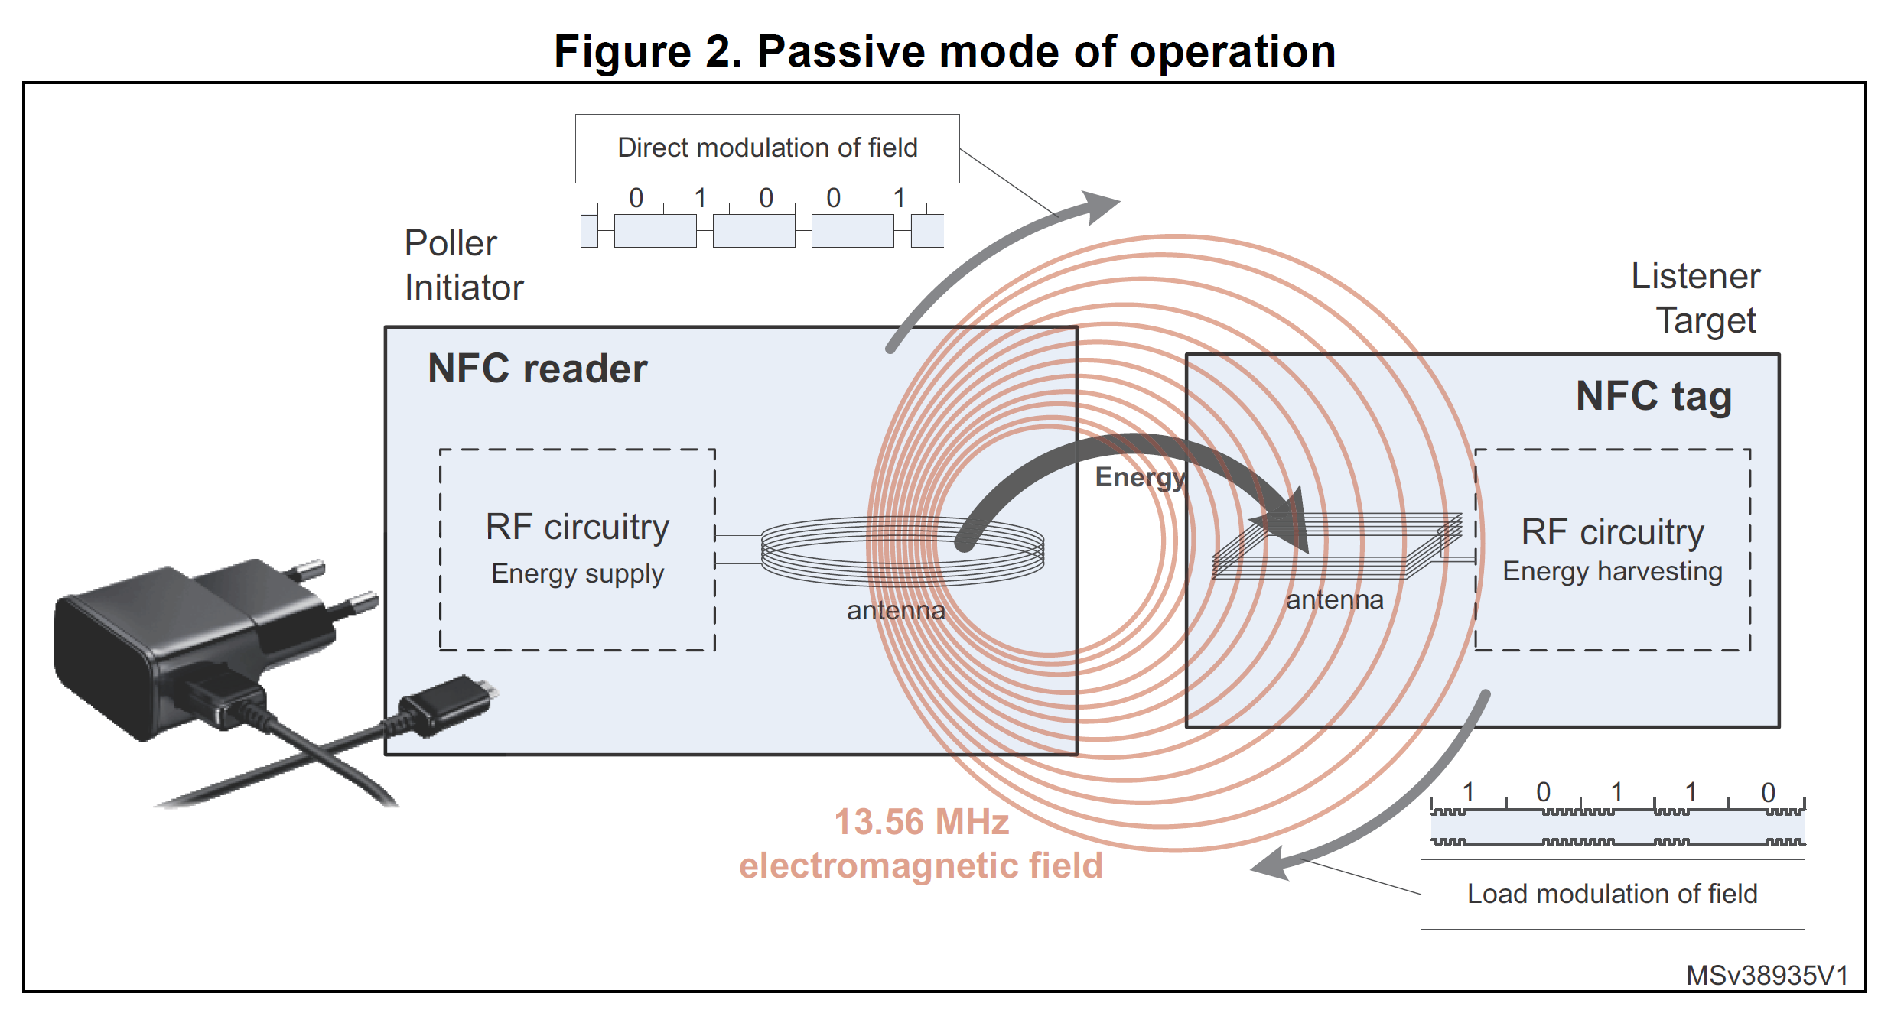

Slide 16
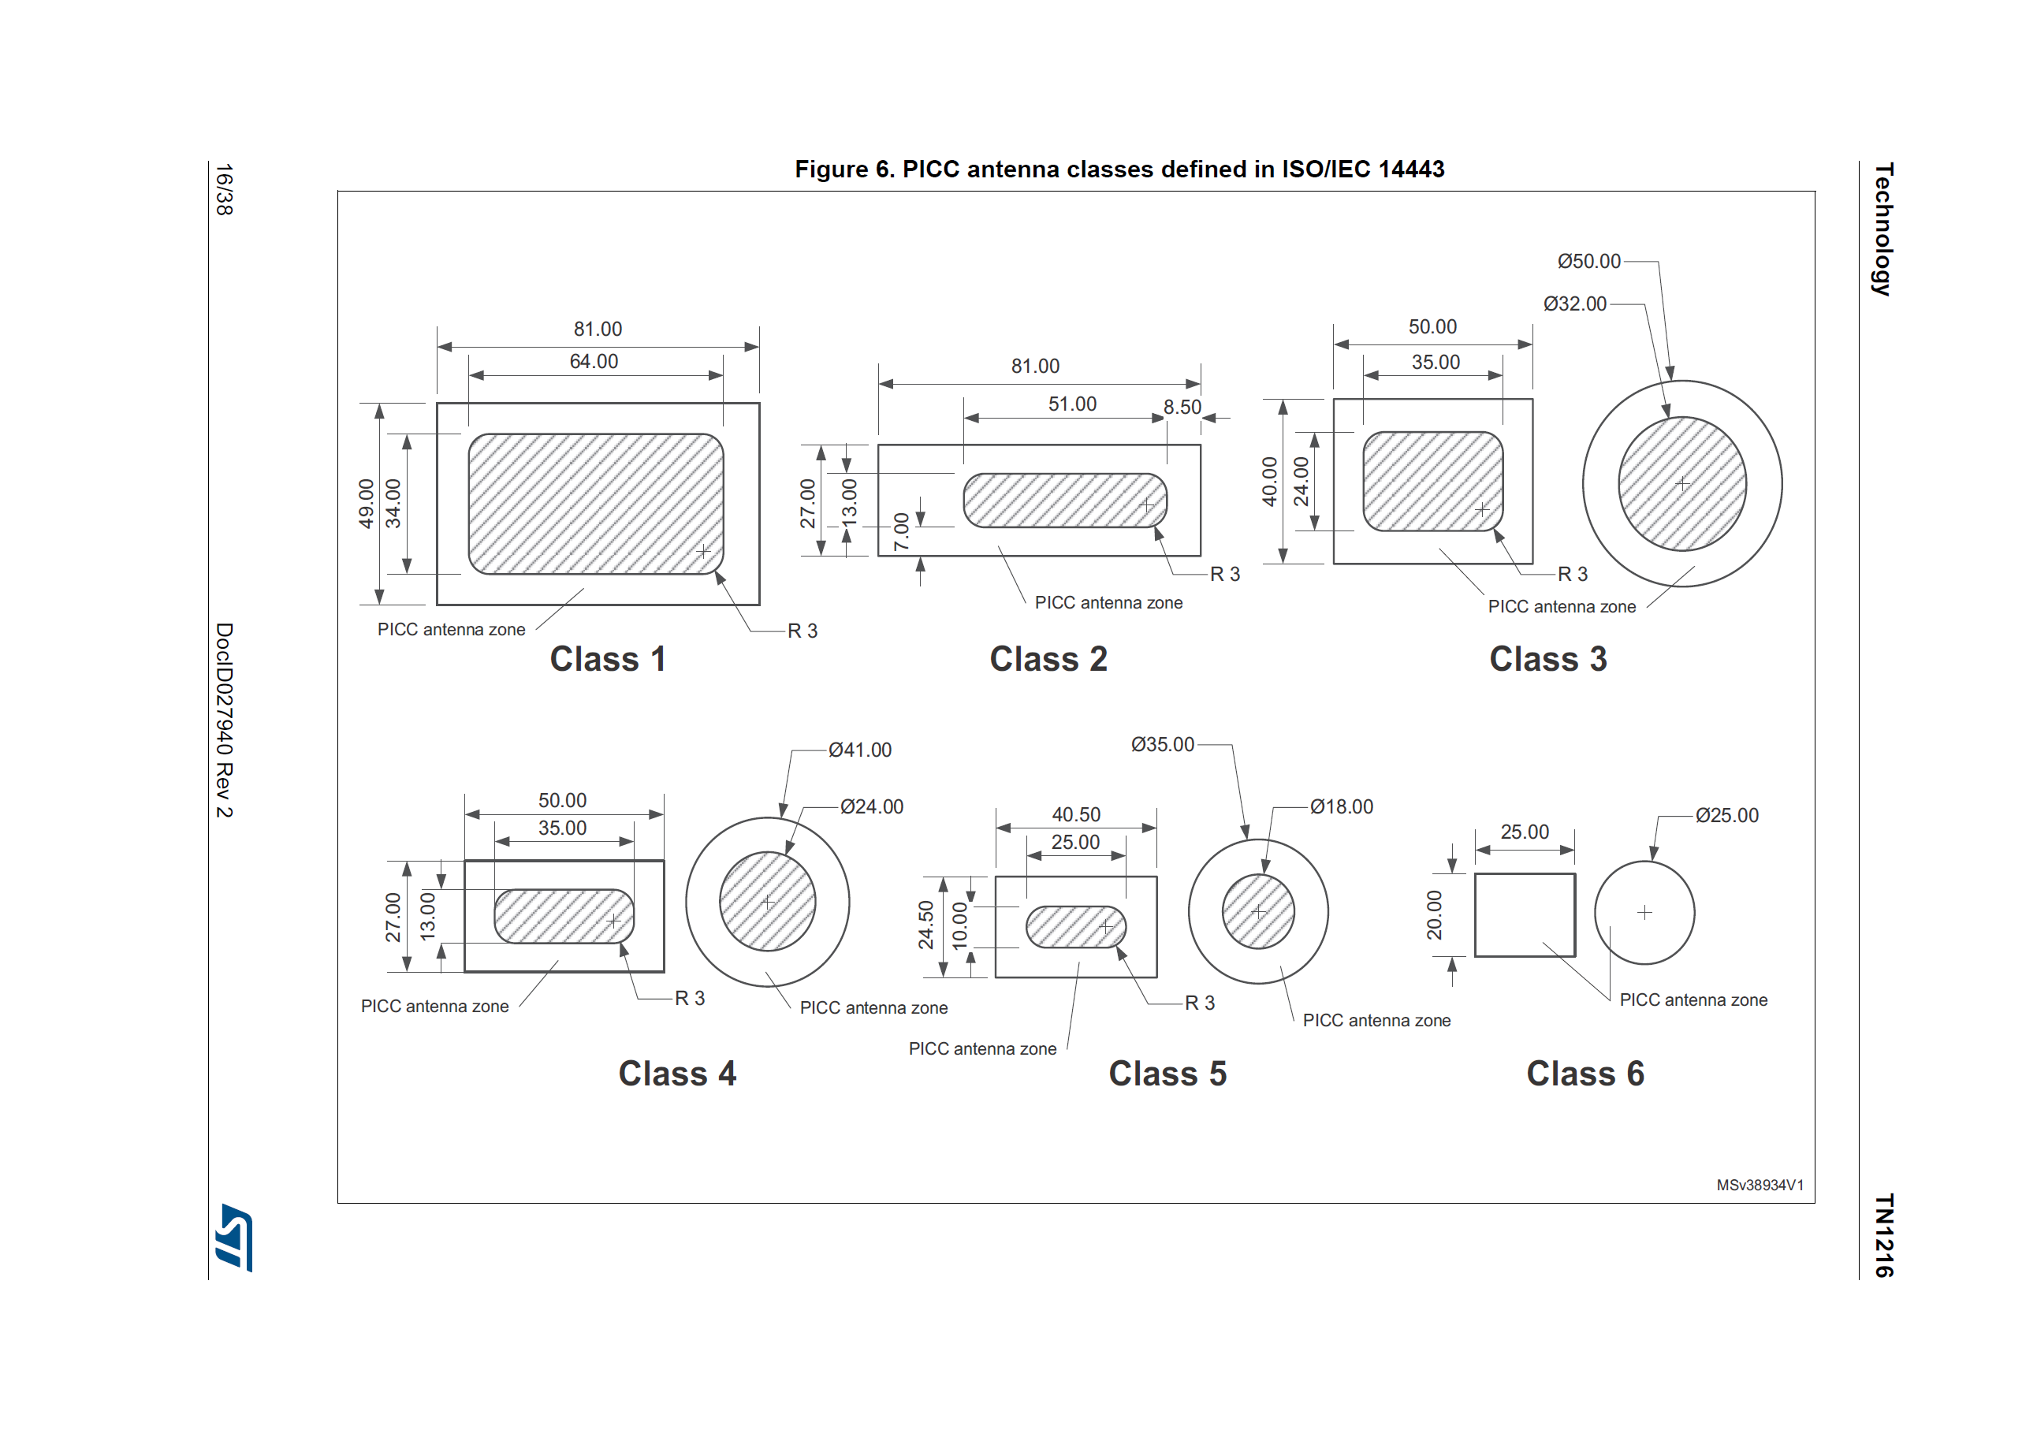

Slide 17



Slide 18



Slide 19



Slide 20



Slide 21



Slide 22
Video
NFC Technology - STMicroelectronics.mp4

Slide 23


Basic antenna theory for NTAG I²C plus tags
6

Slide 24
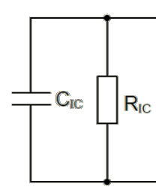
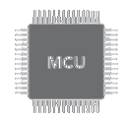
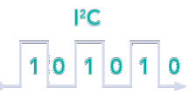
NTAG I²C plus electrical input capacitance
NTAG I²C plus IC
NTAG I²C plus IC connections
La, Lb = NTAG I²C plus pads to be connected to the antenna
FD
Vout
SCL
SDA
Gnd VCC
La
Antenna coil
NTAG I²C plus IC input capacitance
It is the most important factor for the
antenna design.
The form factor and the parameters of the antenna are affected by the input capacitance
to MCU
Lb
NTAG I²C plus equivalent circuit
C_{IC}= NTAG I²C plus input capacitance (50pF)
7

Slide 25
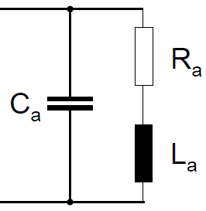
Antenna coil electrical equivalent circuit
NTAG I²C plus IC
Antenna coil
Each antenna is a resonant circuit with a specific input impedance.
FD
Vout SCL
SDA
Gnd VCC
La
This input impedance is complex and consists of an inductance, capacitance as well as some losses represented by a resistance.
Antenna coil
A
n t e
n
na
c o
i l
to MCU
Lb
The actual values depend on
Antenna material
Thickness of conductor
Distance between the windings
Number of turns
Shielding layer
Environment
NTAG I²C plus equivalent circuit
Antenna coil equivalent circuit
C_{IC}= NTAG I²C plus input capacitance (50pF)
8

Slide 26
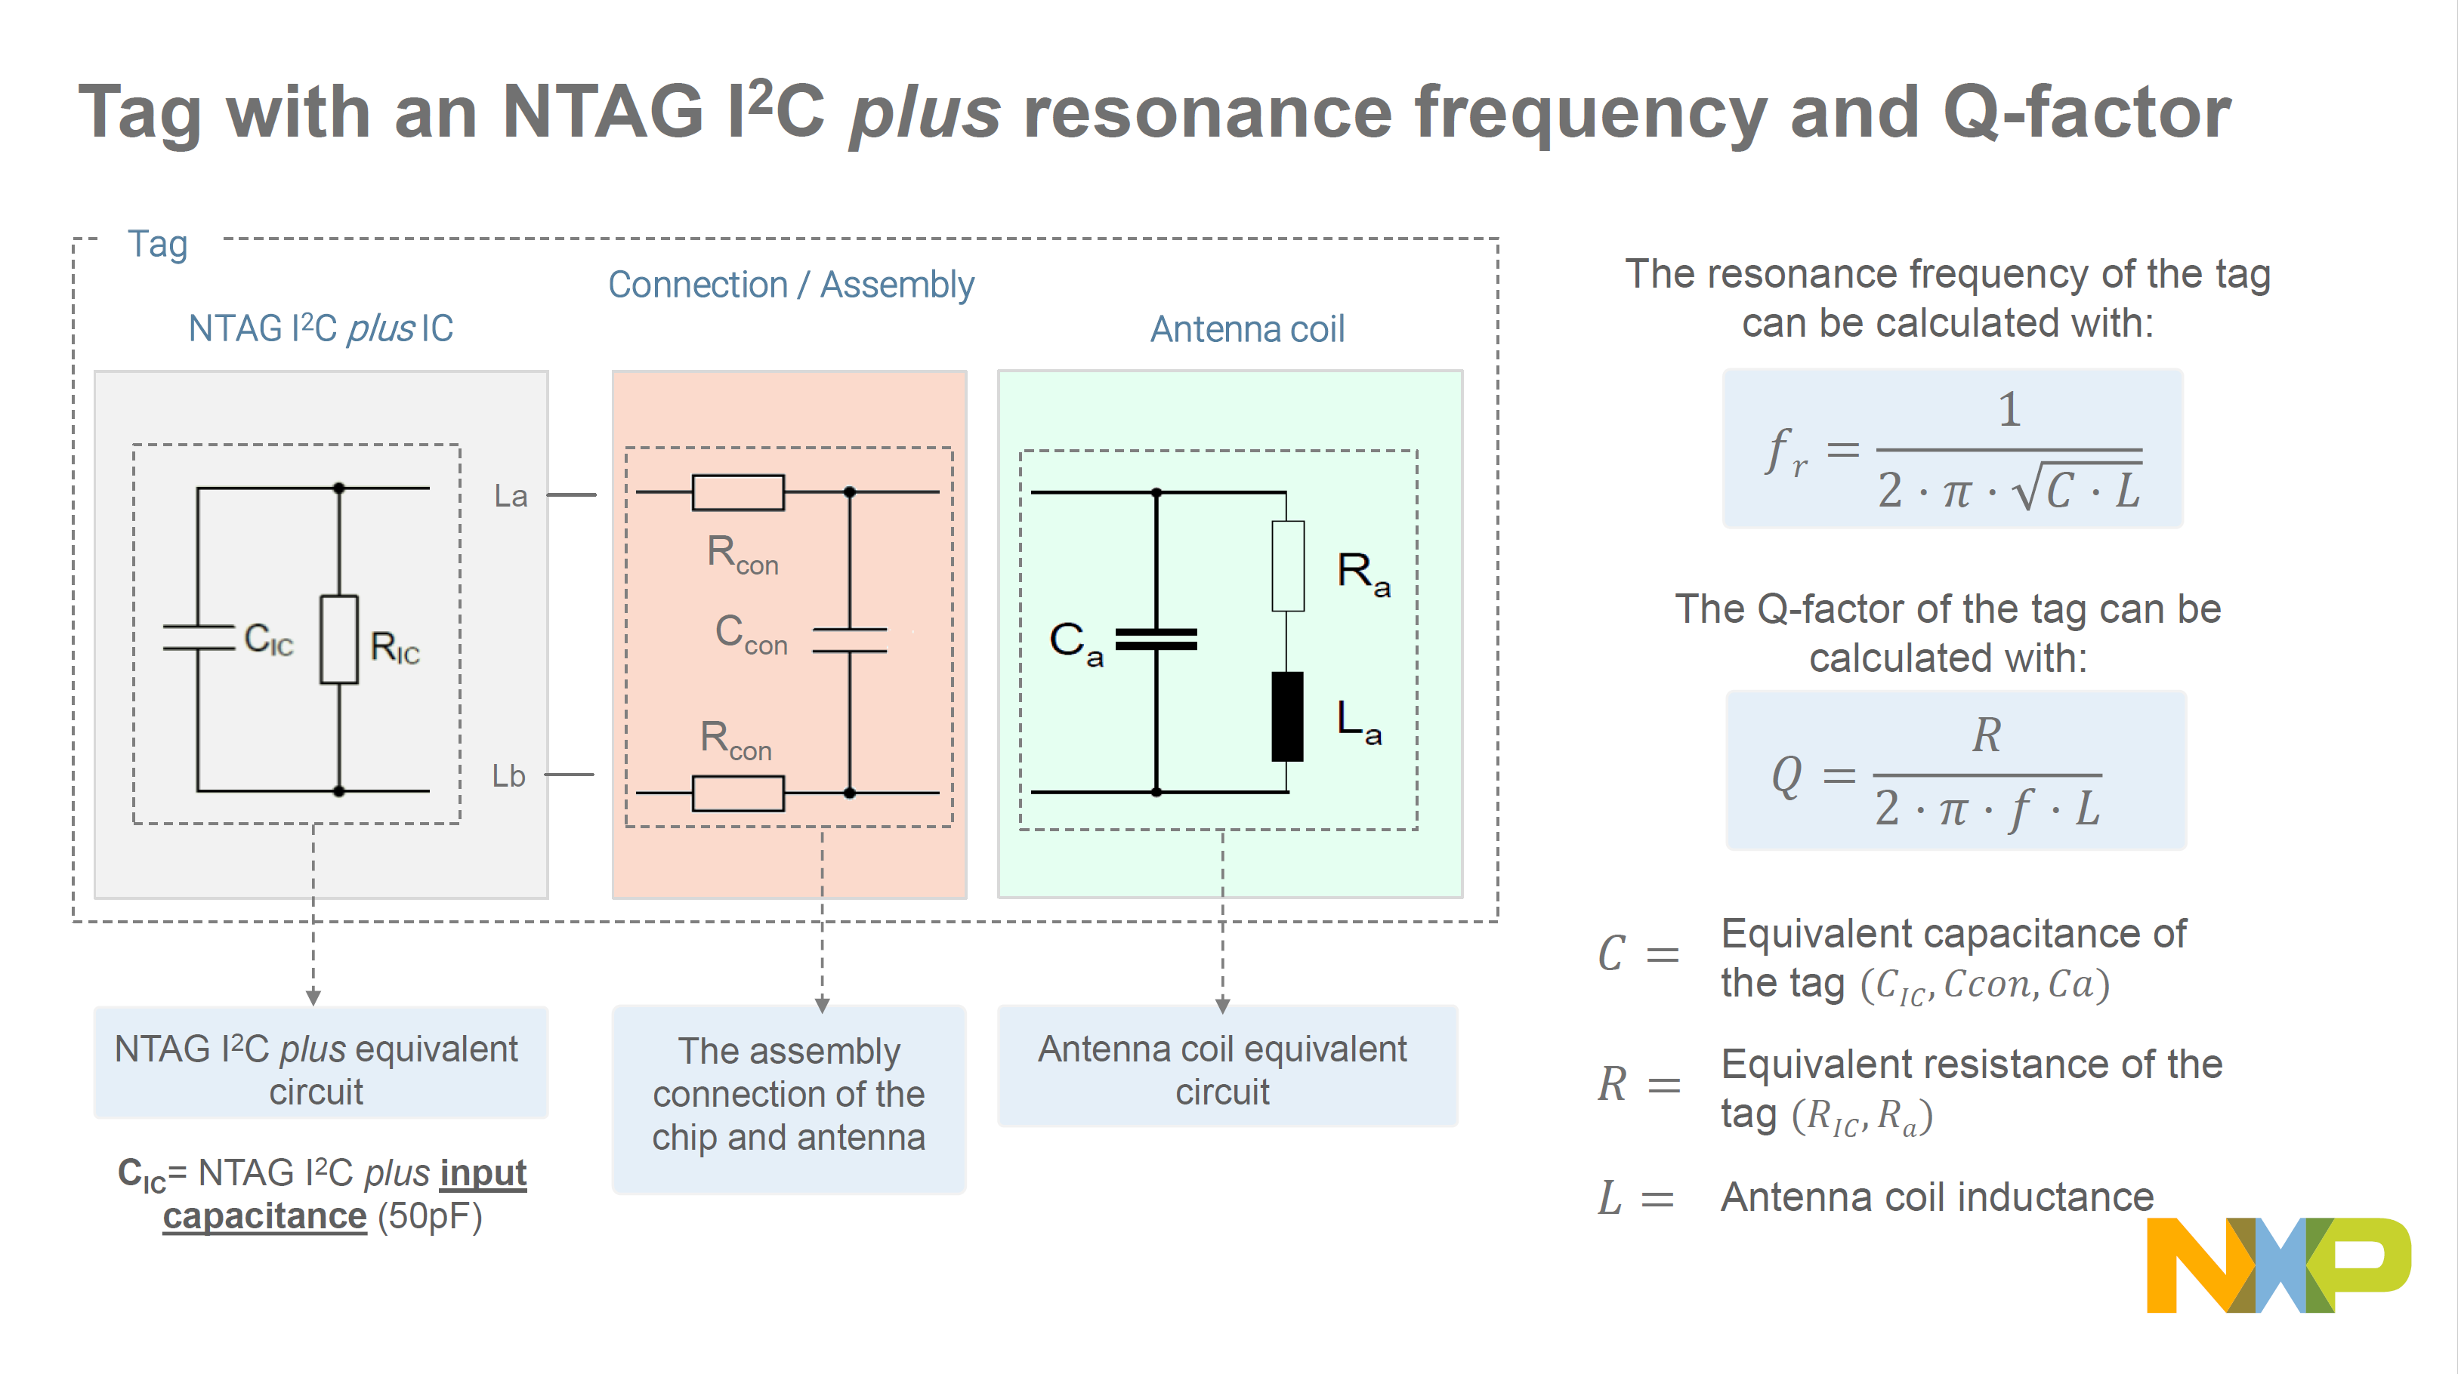

Slide 27
Antenna design procedure for NTAG I²C plus tags
11

Slide 28
Antenna design procedure for NTAG I²C plus tags
1. Design the antenna coil
Determine the size and the specs of the antenna
(number of turns, track width, spacing, etc.)
NTAG I²C plus + antenna coil= resonance circuit
NTAG I²C plus |  | Connection / Assembly |  | Resonant capacitor
2. Measure antenna coil
Characterize R,L,C antenna coil parameters
3. Calculate the resonant capacitor value Determine the value of resonant capacitor to set the tag to the target resonant frequency
Antenna coil
4. Assemble & measure resonant frequency Measure the resonant frequency and adjust the capacitor value if needed
The precision of the antenna equivalent inductance computation, the length of the connection between the chip and its antenna, and the environment (metal surface, ferromagnetic material) impact the tuning frequency.
12

Slide 29
Design the antenna coil
13

Slide 30
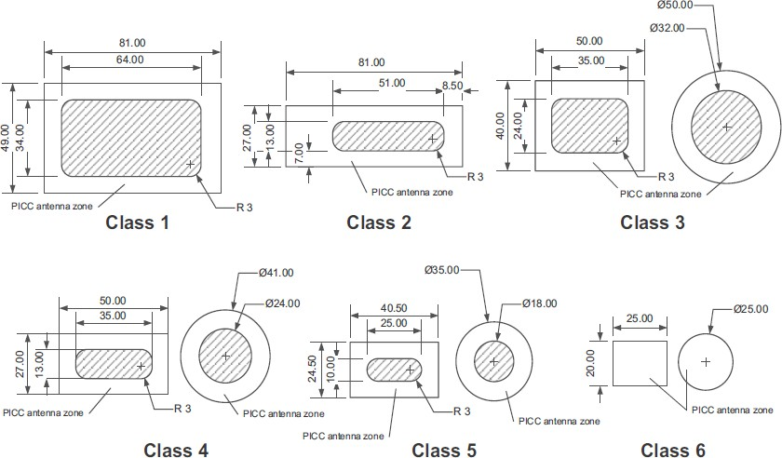
Antenna class based on ISO/IEC14443
ISO/IEC 14443-1 defines 6 antenna classes, also referred to in ISO/IEC 15693.
The use of ISO/IEC14443 antenna class is optional but it has been established that the use of a prescribed class may enhance interoperability
14

Slide 31
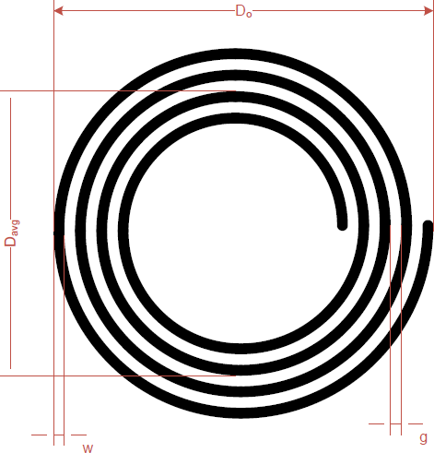
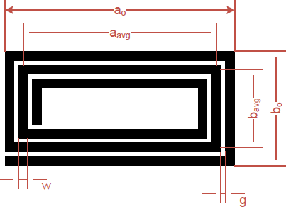
Antenna parameters for rectangular and round antennas
Antenna geometry
Material properties
ρ → Electric conductivity ε_{r} → Permittivity of card material
D₀ → | Definition of the antenna diameter (mm) | •
w → g → t → N → | Track width in mm, Gap between tracks (mm), Track thickness Number of turns | •
Antenna geometry
a₀ → Definition of the overall length (mm)
b₀ → Definition of the overall width (mm)
w → Track width in mm
g → Gap between tracks (mm)
t → Track thickness
N → Number of turns
Inductance of an antenna depends on the antenna dimensions and material properties
15

Slide 32
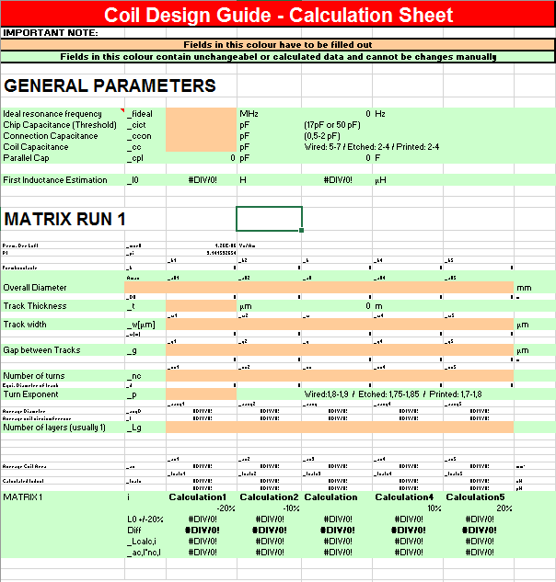
Coil design calculation sheet
This coil design guide calculation sheet uses antenna dimensions and estimates the antenna equivalent inductance.
The following steps are a reliable method to design and fine tune a custom antenna coil:
Estimation of the electrical parameters
Definition of the target inductance
Definition of the dimensions
Definition of the matrix run
Production of samples
Selection of the best coil parameters
Definition of second matrix run (if needed)
Excel calculation sheet tool included in https://www.nxp.com/docs/en/application-note/AN11276.zip
16

Slide 33
Measure the antenna coil parameters
17

Slide 34
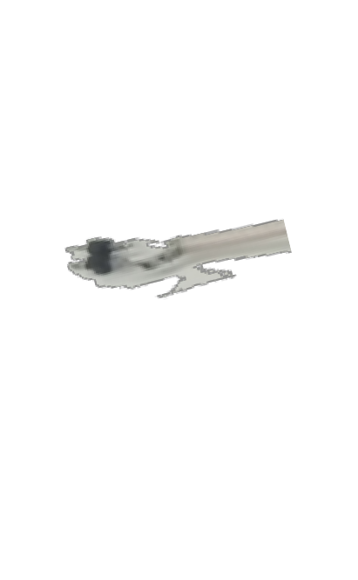
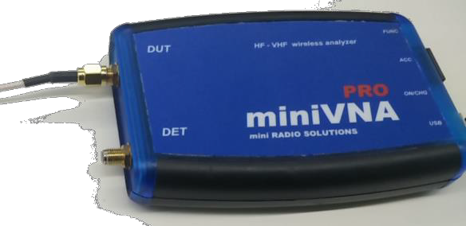


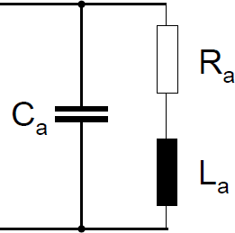
Measuring the antenna coil parameters
The antenna loop has to be connected to a network analyzer to measure the antenna equivalent circuit (R_{a}, L_{a}, C_{a})
Before each measurement, the network analyzer must
be calibrated (open, short and load compensation).
Settings: S11
Chart: Smith Z
Start frequency: 1 MHz
Stop frequency: Above self-resonant frequency
NTAG I²C plus
Antenna coil
High-end or Low-end network analyzer (e.g., miniVNA PRO)
Note: The antenna has to be at the final mounting position to consider all parasitic effects like metal influence on quality factor, inductance and additional capacitance
Fig. Antenna series equivalent circuit (C_{a}, L_{a}, R_{a})
18

Slide 35
Calculate the resonant capacitor value
19

Slide 36

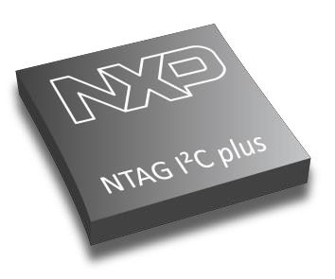

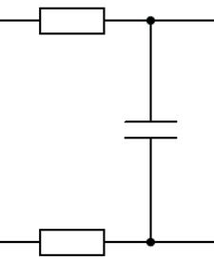
Calculating the parallel resonance capacitor
Antenna coil
We measure the current system resonance frequency (𝑓_{𝑟 − 𝑐𝑢𝑟𝑟𝑒𝑛𝑡}) after connecting the NTAG I²C plus to the antenna coil.
If it is not 𝑓_{𝑟 − 𝑐𝑢𝑟𝑟𝑒𝑛𝑡}~ 13.56𝑀𝐻𝑧 , we calculate the system capacitance at the current resonance frequency with this formula:
1
𝐶
=
La
^{R}con ^{C}con
^{R}con
𝑓𝑟 ₋ 𝑐𝑢𝑟𝑟𝑒𝑛𝑡
2 · 𝜋 · 𝑓
² · 𝐿
𝑟𝑒𝑠
A
n t e
n
na
c o
i l
Note: The inductance of the system is basically the inductance of the antenna (L=La).
Lb
NTAG I²C plus IC
Connection
Antenna coil
20

Slide 37
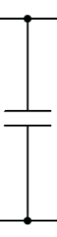
Calculating the parallel resonance capacitor (II)
Resonance capacitor
Antenna coil
If we fix the desired system resonance frequency (𝑓_{𝑟 − 𝑡𝑎𝑟𝑔𝑒𝑡}), the capacitance required so that the system resonates at that target frequency can be calculated with this formula:
1
𝐶 =
𝑡𝑎𝑟𝑔𝑒𝑡
2 · 𝜋 · 𝑓_{𝑟}
² · 𝐿
𝑡𝑎𝑟𝑔𝑒𝑡
−
We can calculate the extra capacitance that needs to be soldered in parallel (C_{Res}) by:
Tag
La
^{C}Res
^{R}con ^{C}con
^{R}con
^{𝐶}𝑅𝑒𝑠 ^{= 𝐶}𝑡𝑎𝑟𝑔𝑒𝑡 ^{− 𝐶}𝑓𝑟 ₋ 𝑐𝑢𝑟𝑟𝑒𝑛𝑡
A
n t e
n
na
c o
i l
Note: For single tag operation, a tuning slightly above 13.56 MHz would lead to maximum read-/write distance. Due to manufacturing tolerances, a nominal frequency of 14.5 MHz for single tag operation is recommended.
Lb
NTAG I²C plus IC
Resonance capacitor
Connection
Antenna coil
21

Slide 38
Assemble & measure resonant frequency
22

Slide 39
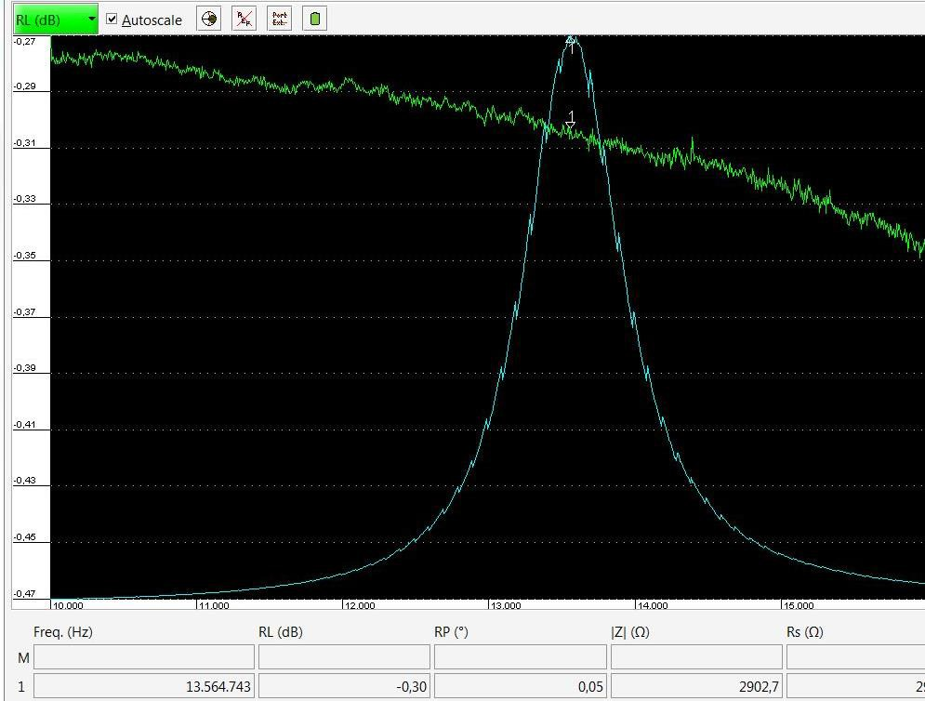

Assembling and measuring the tag resonant frequency
Assemble the calculated 𝑪_{𝒓𝒆𝒔} capacitor in your design.
Then, measure the resonant frequency (𝒇_{𝒓𝒆𝒔}) at which the resistance impedance (Z) is maximum
If the resonant frequency is not the target resonant frequency, fine tune the capacitor value. If the frequency is high, increase the capacitor value; if low, decrease it.
Resonance Antenna coil
capacitor
Fig. Example of a tag adjusted to 𝒇_{𝒓𝒆𝒔} = 13.564 MHz
23

Slide 40
Design
How to design a good-looking and stable NFC Tag PCB

Slide 41
ISO 7810
ISO 7810，是身份证、银行卡等尺寸的国际标准，分为ID-1、ID-2、ID-3及ID-000四种。现时采纳的版本为2003年版。
ID-1的规定尺寸为85.60×53.98毫米（3.370×2.125英寸），常用于身份证、银行卡（如提款卡、信用卡）、驾照、个人名片，以及商店发出的忠实顾客卡等。
其长宽比与黄金分割（1.618:1）接近。
ISO 7813规范ID-1塑胶银行卡的附加特性，包括0.76毫米厚度，及3.18毫米半径的圆角。
样式 | 尺寸 | 用途
ID-1 | 85.60 × 53.98 mm | 绝大多数银行卡及身份证
ID-2 | 105 × 74 mm | 法国身份证等；签证
ID-3 | 125 × 88 mm | 护照
ID-000 | 25 × 15 mm | SIM卡

Slide 42
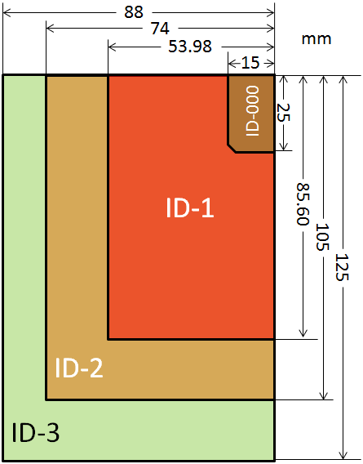
设计为
85.60×53.98毫米
3.18毫米半径的圆角
0.76毫米厚度（做0.8mmPCB板）

Slide 43
丝印和Top图案设计和导入
使用Ai设计表面丝印BMP

Slide 44
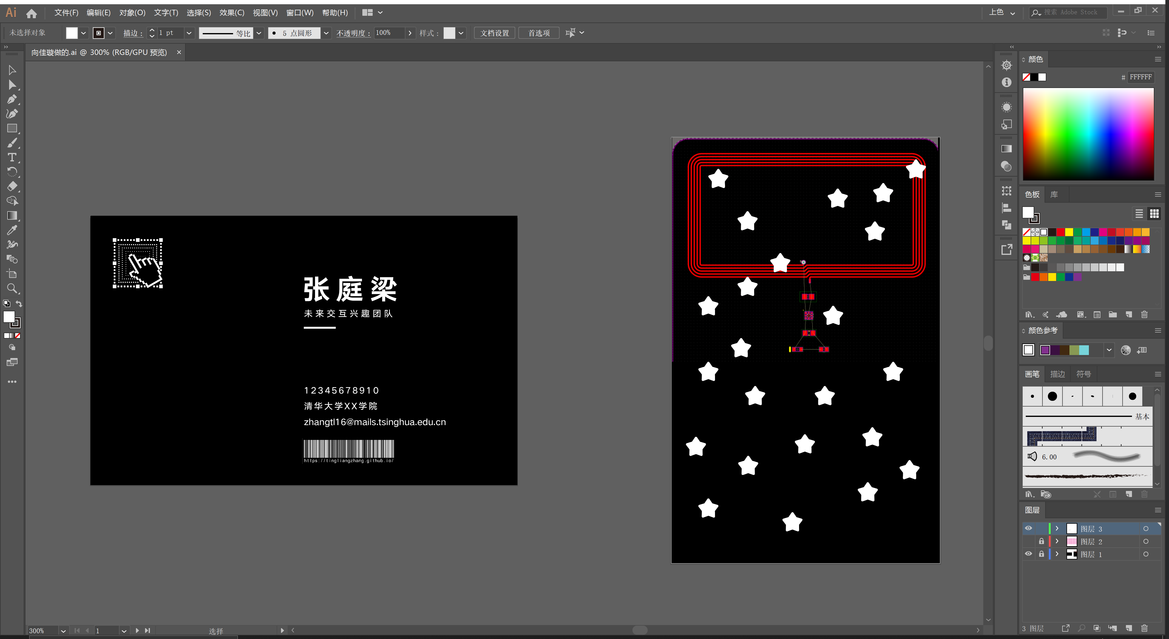

Slide 45
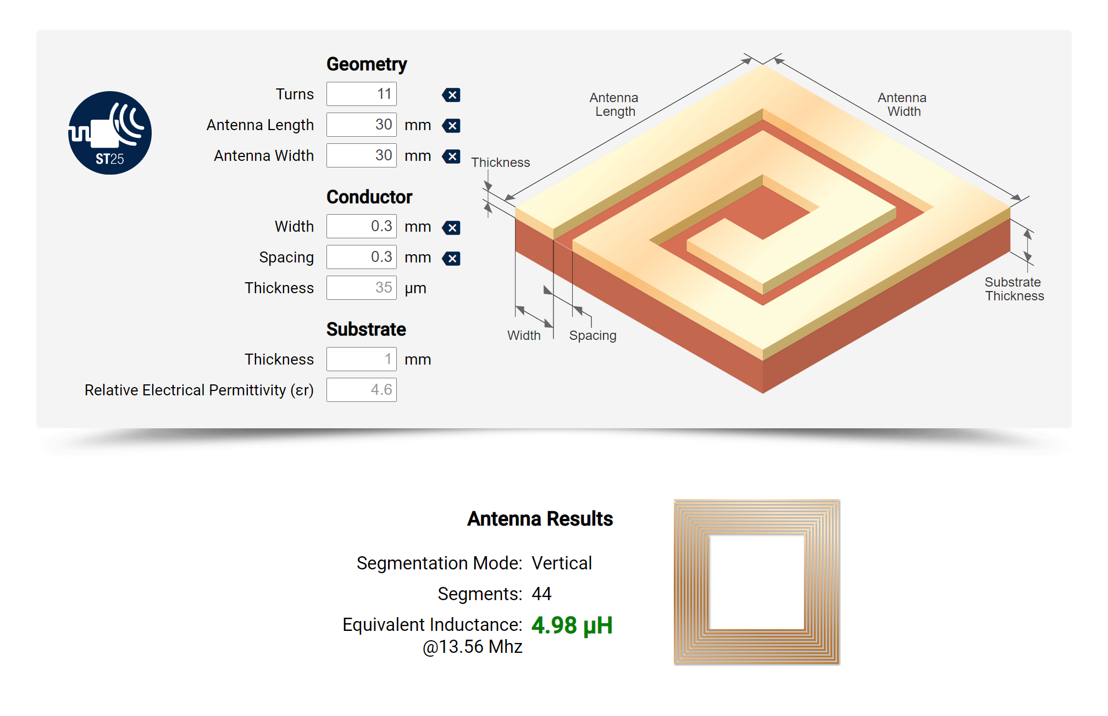

Slide 46
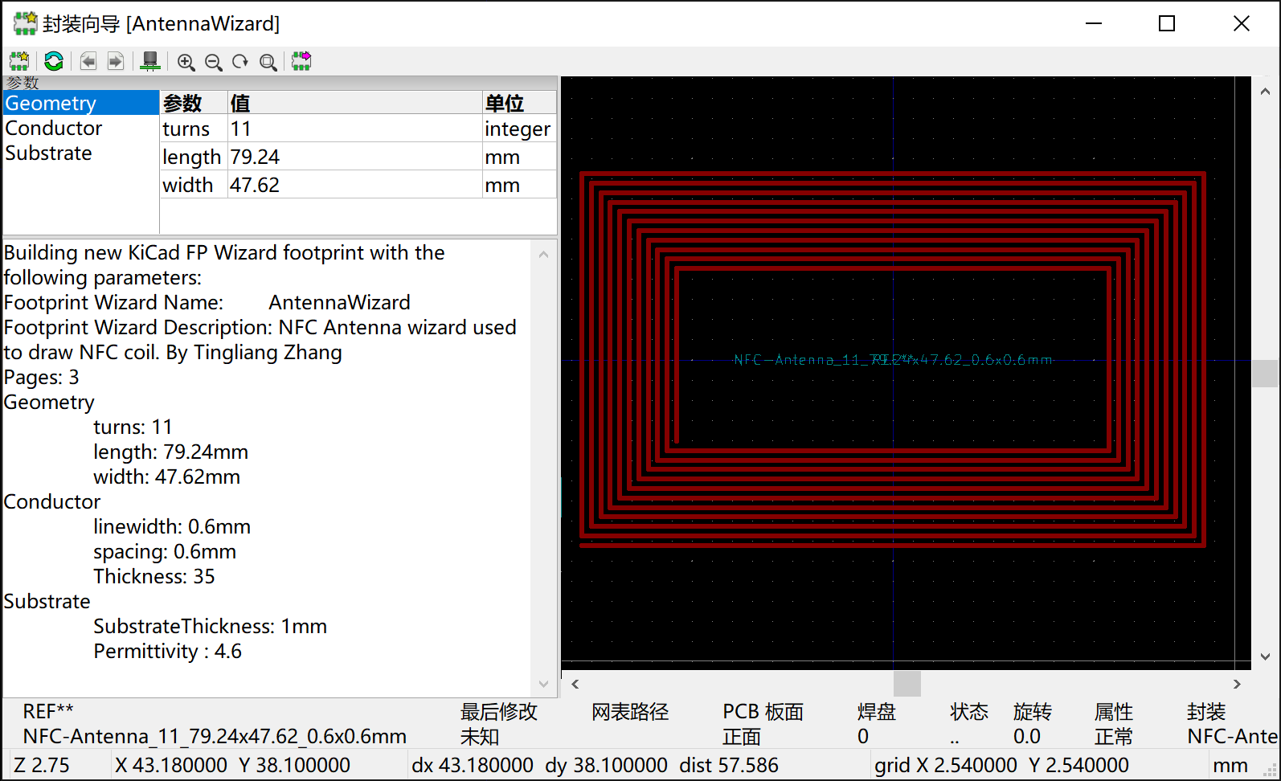

Slide 47
PCB Intro
What is PCB

Slide 48
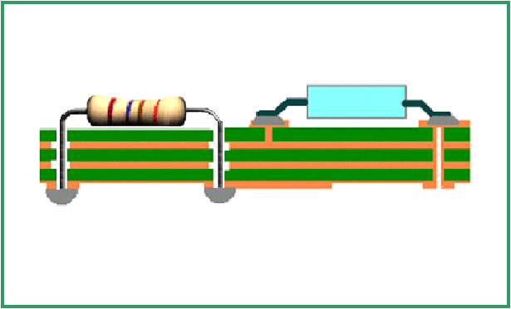

PCB的材料和结构
材料—玻璃纤维
结构—多层板
Top Layer (元件面)
Via (过孔)
铜膜（敷铜板）
插针式元件
SMD元件
玻璃纤维板
Bottom Layer (焊接面)
焊锡
Notes:
两种：
通孔式：
表面式：

Slide 49
Video
https://www.bilibili.com/video/BV1pf4y1v7RL/

Slide 50
PCB Design Software
Altium Designer
KiCAD
Autodesk Eagle
…… etc.

Slide 51
PCB代工厂
嘉立创
国外：https://jlcpcb.com/
国内：https://www.sz-jlc.com/
捷多邦
国外：https://www.pcbway.com/
国内：https://www.jdbpcb.com/

Slide 52
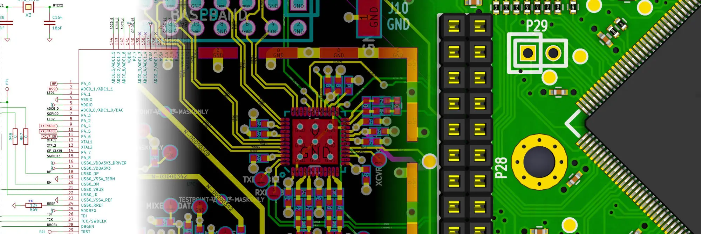
KiCad EDA
A Cross Platform and Open Source Electronics Design Automation Suite

Slide 53
Introduction to KiCad
KiCad is an open-source software tool for the creation of electronic schematic diagrams and PCB artwork. Beneath its singular surface, KiCad incorporates an elegant ensemble of the following stand-alone software tools:
Program name | Description | File extension
KiCad | Project manager | *.pro
Eeschema | Schematic and component editor | *.sch, *.lib, *.net
Pcbnew | Circuit board and footprint editor | *.kicad_pcb, *.kicad_mod
GerbView | Gerber and drill file viewer | \*.g\*, *.drl, etc.
Bitmap2Component | Convert bitmap images to components or footprints | *.lib, *.kicad_mod, *.kicad_wks
PCB Calculator | Calculator for components, track width, electrical spacing, color codes, and more…​ | None
Pl Editor | Page layout editor | *.kicad_wks

Slide 54
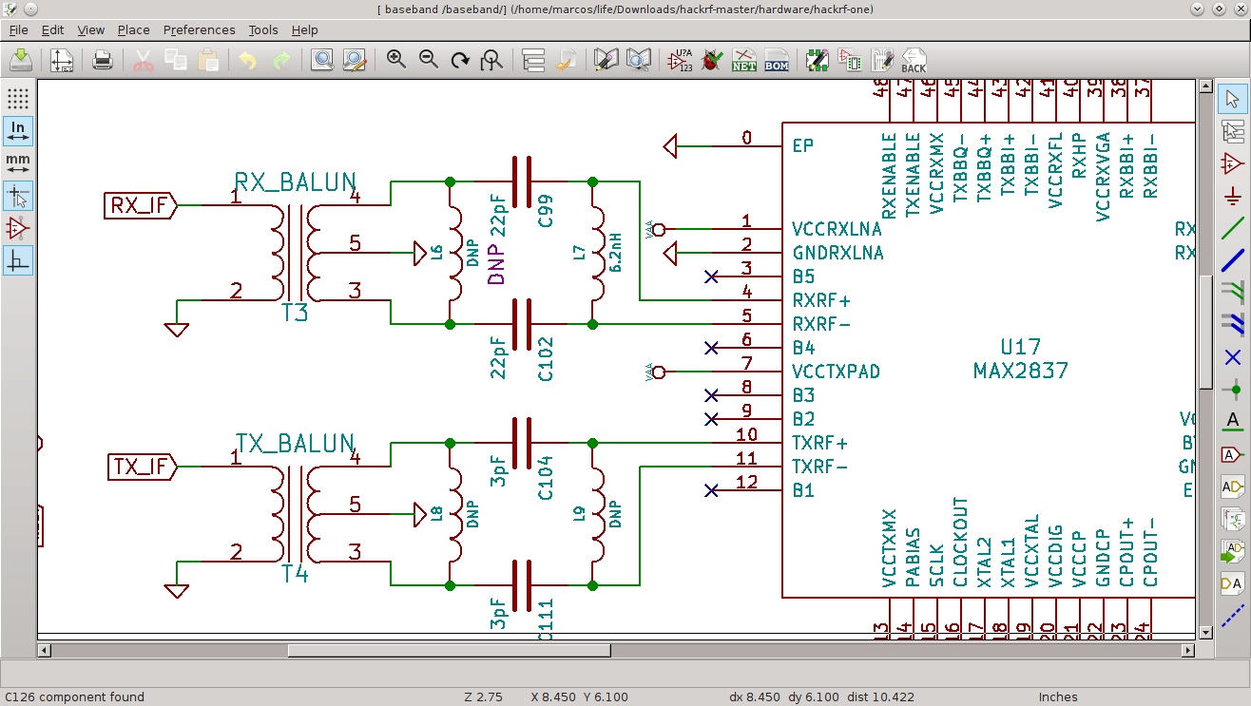

Slide 55
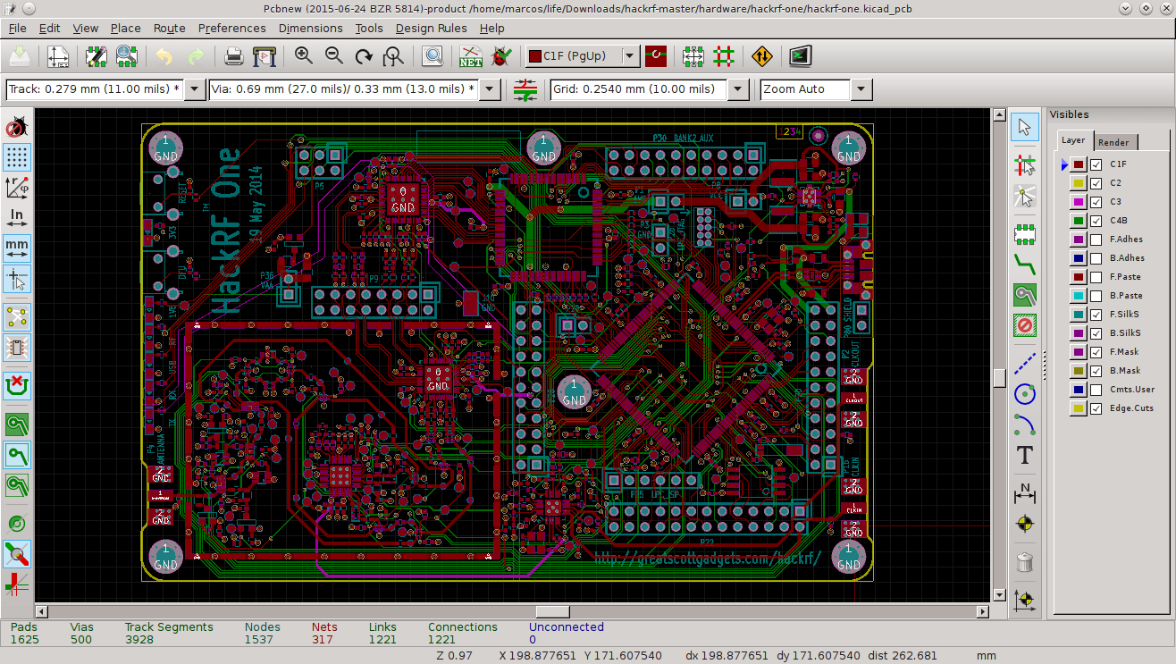

Slide 56
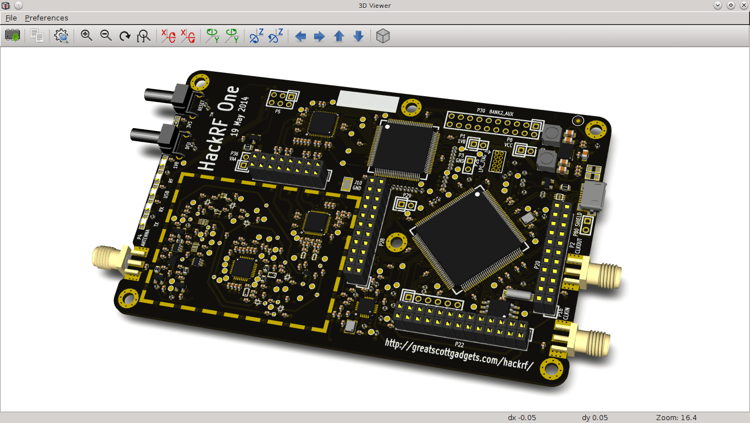

Slide 57
Thanks
My Wechat ID lbyzztl

